Slide 1
Maximum Likelihood
Estimation
The maximum likelihood estimate (mle) of a parameter is the parameter value for which the probability of observing our data is maximized.
For instance, say weights follow a normal distribution and the average weight of a sample is 150.
What is more likely, observing a sample mean of 150 when the true mean is 100 or when the true mean is 150?

Slide 2
Maximum Likelihood
Estimation
Again, the maximum likelihood estimate of a parameter is the parameter value for which the probability of observing our data is maximized.
The first step in maximum likelihood estimation is to create the specific likelihood function to be maximized.
The likelihood function is an expression that yields a quantity similar to the probability of the observed data for given parameters, which is what we want to maximize.
Such as the probability of observing a sample mean of 150 with a true mean of 150 or the probability of observing a sample mean of 150 with a true mean of 75.

Slide 3
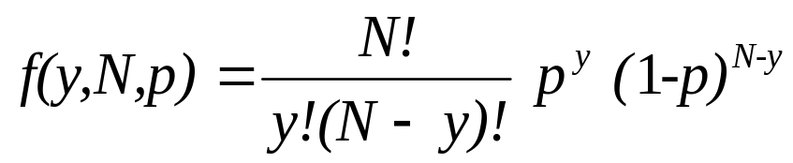
Maximum Likelihood
Estimation
Consider a Binomial random variable. A Binomial random variable Y measures the number successes out of N trials.
The parameters are N and p, where p is the probability of success for an individual trial.

Slide 4
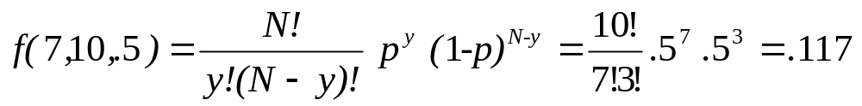
Maximum Likelihood
Estimation
For our example, we consider getting a heads when we flip a coin a success, and we flip a coin 10 times, N=10 and p =.5.
Y, a Binomial random variable, measures the number of heads, that are successes.
The probability Y=7 is then

Slide 5
Maximum Likelihood
Estimation
Now suppose we do not know p and we want to estimate it.
Likelihood function: probability of observed data as a function of parameter.
We can calculate the probability of observing our data for different parameter values.
For example, suppose we have 10 trials and we observe 8 successes. What is the probability that we observed 8 successes out of 10 trials?

Slide 6
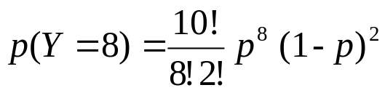
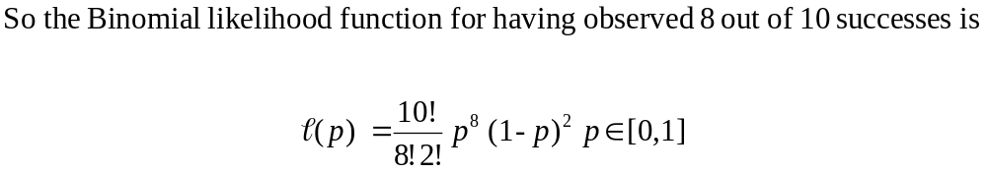
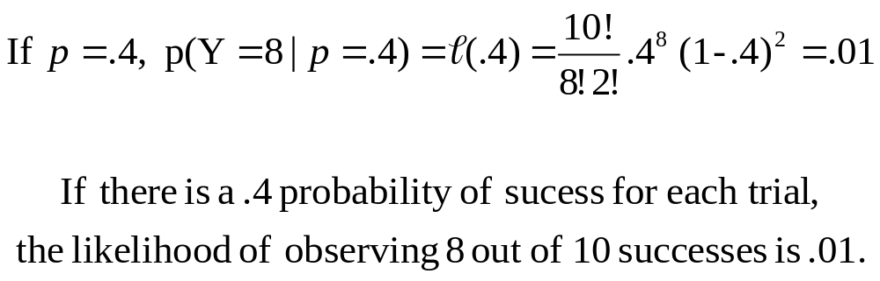
Maximum Likelihood
Estimation

Slide 7
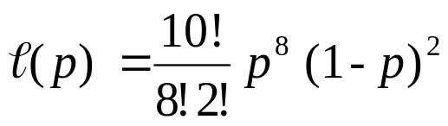
Maximum Likelihood
Estimation
The maximum likelihood estimate of a parameter is the parameter value for which the probability of observing our data is maximized.
Since the likelihood function is the probability of observing our data as a function of the parameter, the maximum likelihood estimate is the parameter value for which the likelihood function takes its maximum.
So we need to find the value of p, such that
is maximized.

Slide 8
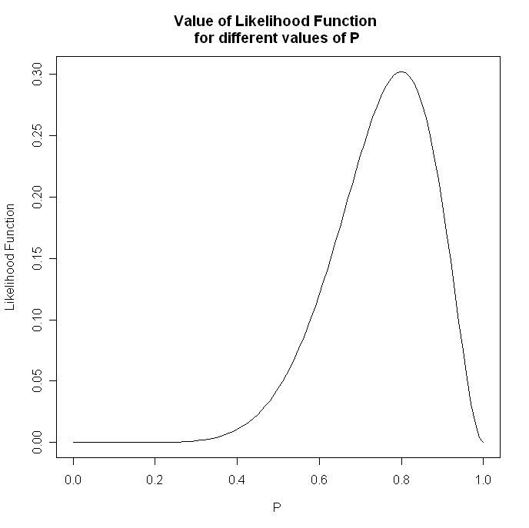
This is a plot of the likelihood function for various values of p.
Note at p=.4, the likelihood function equals .01

Slide 9
We want the value of p, where the likelihood function is maximized.
Note at p=.8, the likelihood function equals about .3, its maximum value

Slide 10
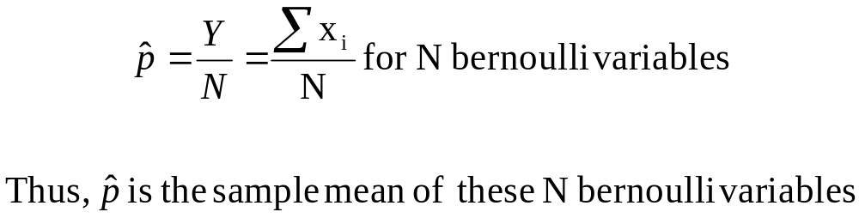
Maximum Likelihood
Estimation
Thus, in this example, we would estimate p to be .8, which is the sample proportion . This is the maximum likelihood estimate of p.
In general, the maximum likelihood estimate of p is the sample proportion p(hat).

Slide 11
Maximum Likelihood
Estimation
For a Normal distribution, the mle of the true mean μ is the sample mean.
Again, suppose weights follow a normal distribution and the average weight of a sample is 150.
The probability of observing this data is greater for a normal distribution with a mean μ=150 than for a normal distribution with a mean of any other value.
Thus the maximum likelihood estimate of μ is the sample mean 150.

Slide 12
Maximum Likelihood
Estimation
Lets see this mathematically.
Suppose we observe three weights 100, 150, 200 and we know that the variance is 5.
A probability density function is an expression that yields a quantity similar to the probability a variable takes a particular value.
For example f(X=100) yields a quantity similar to the probability that someone's weight is 100.

Slide 13
Maximum Likelihood
Estimation
We want to determine a quantity similar to the probability that someone weighs 100, the second person weighs 150, and the third person weighs 200.
This is expressed as f(X₁ = 100, X₂=150, X₃=200).
However, since we are assuming our observations are independent we have that
f(X₁=100, X₂=150, X₃=200) = f(X₁ = 100)f(X₂=150)f(X₃= 200)
Really, these are all conditioned on a given mean μ and standard deviation σ.

Slide 14
Maximum Likelihood
Estimation
The likelihood function is an expression that yields a quantity similar to the probability of the observed data for given parameters, which is what we want to maximize.
The likelihood function is then the probability we observe the three observations we did, for given parameters, which is equal to
f(X₁ = 100)f(X₂=150)f(X₃= 200)
In general, for some parameter θ, the likelihood function is:
L(θ) = ∏ F(X_{i} = x_{i}|θ) for i=1 to n.

Slide 15
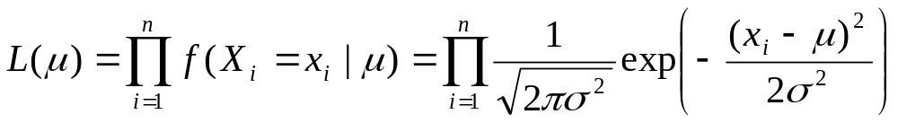
Maximum Likelihood
Estimation
For the mean μ of a normal distribution we then have that
We need the value of μ that maximizes this term, that is maximizes the probability of observing the data that we did.
To maximize this with respect to μ, we can take the derivative, set it equal to 0, and solve for μ.
However, since the expression is monotonic, we can maximize the log with respect to μ and get the same value.

Slide 16
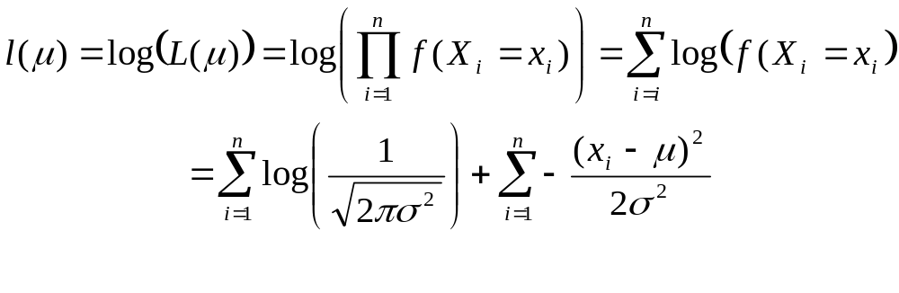
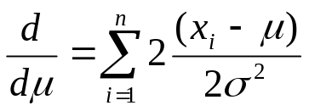
Maximum Likelihood
Estimation
The loglikelihood function is much easier to handle and take the derivative of.
Taking the first derivative with respect to μ gives

Slide 17
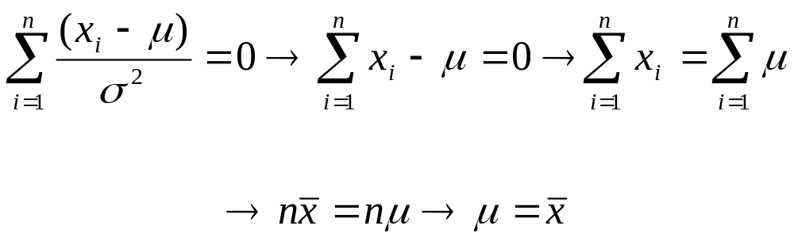

Maximum Likelihood
Estimation
Setting the term equal to 0, we have
Typically, we write this estimate, the mle of μ as μ(hat):

Slide 18
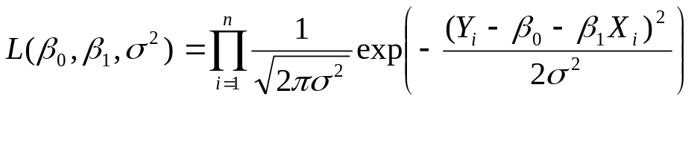

Normal
Error Model
For a normal error regression model, we have that each Y_{i} is normally distributed with mean β₀ + β₁ X and variance σ².
The likelihood function for β₀, β₁, and σ², is then
The values of β₀, β₁, and σ² that maximize this likelihood are the mles and are denoted as:

Slide 19
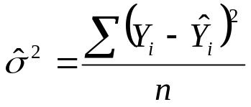
Normal
Error Model
Solving analytically gives that β₀(hat)= b₀ and β₁(hat) = b₁, the least squares estimates.
However, σ²(hat) is not quite the MSE . The SSE is divided by n instead of n-2. We have
The mle σ²(hat) is biased and ordinarily the unbiased estimator MSE is used.

Slide 20
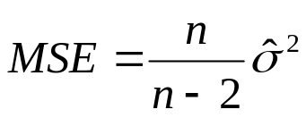
Normal
Error Model
We have the equality,
When the sample size is large, the difference between the mle σ²(hat) and the MSE is small.

Slide 21
Maximum Likelihood
Estimation
The mles have their own distributions, called sampling distributions, with expected values and variances.
When based on large samples;
It is not possible to find estimators that are more precise in terms of having smaller standard errors (they are efficient).
They have little, if any, bias, with the bias diminishing as the sample size increases.
They have approximately normal sampling distributions.

